Slide 1
As you enter:
Ten minutes private reading.
Fill in your reading record at the end.
Read your corrections. Copy out any spelling corrections 3 times on the spellings page at the back of your book.
Lesson Objectives:
To be able to explain what is meant by the term ‘dystopian novel.’
To be able to explain why the novel we are studying this term fits into the category.
To have begun to create your own dystopia.

Slide 2
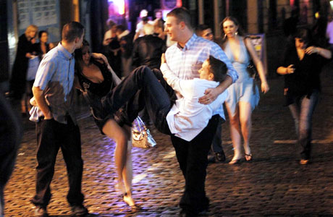

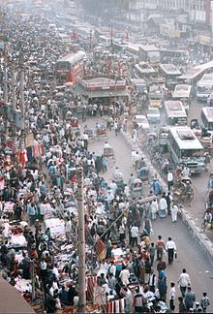
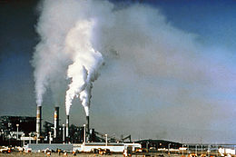
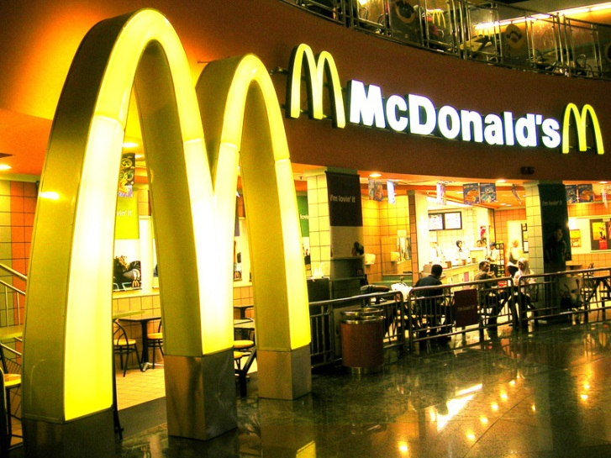
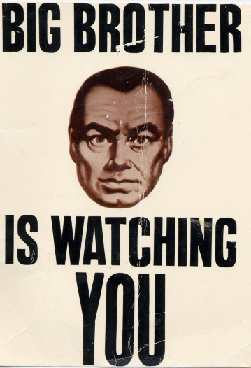
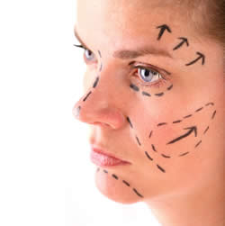
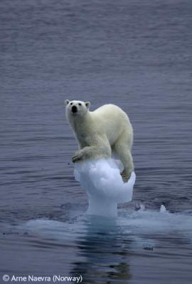
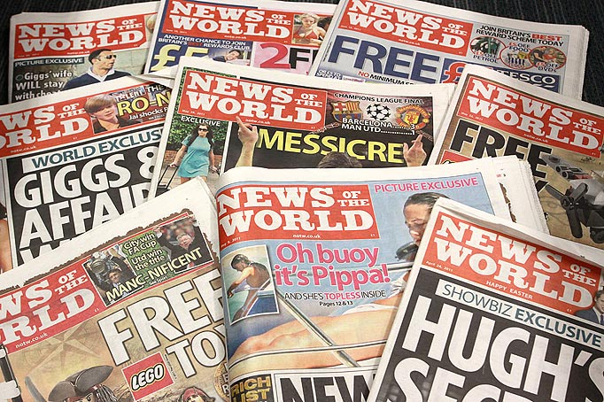
What do these photos represent and why should we be worried about each issue?
Which are you most worried about?

Slide 3
Key Definition
Dystopia: A dystopia is a FUTURE society
that is somehow NEGATIVE or frightening.
It is based on a problem that the author
feels exists in the present world. In the
dystopia that problem is exaggerated and
has become far worse.
e.g. Our current obsession with the quest for the ‘perfect looks’ leads to a world where it is obligatory for every 16 year old girl to attend a ‘meeting’ where she is ‘assessed’ and given a list of cosmetic surgery (or ‘adjustments’) that she has to undergo.
e.g. Our current obsession with the quest for the ‘perfect looks’ leads to a world where it is obligatory for every 16 year old girl to attend a ‘meeting’ where she is ‘assessed’ and given a list of cosmetic surgery (or ‘adjustments’) that she has to undergo.
e.g. Our current obsession with the quest for the ‘perfect looks’ leads to a world where it is obligatory for every 16 year old girl to attend a ‘meeting’ where she is ‘assessed’ and given a list of cosmetic surgery (or ‘adjustments’) that she has to undergo.
Work with your partner to create your own based on your list.
Create your own based on your list of problems in the 21st century world.

Slide 4
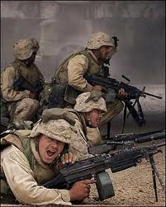
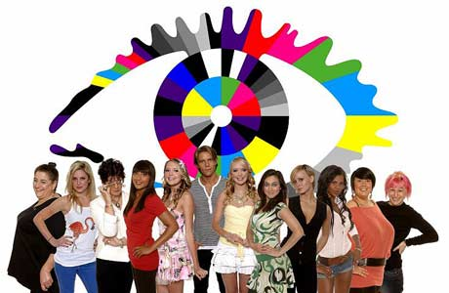
“It’s opening kids’ eyes to what’s going on in our society, the control and monitoring by government using technology and how people are desensitized to violence in video games—issues that we face every day.”
“The book holds up a terrible kind of mirror: This is what our society could be like if we became desensitized to trauma and to each other’s pain.”
“One night I’m sitting there flipping around and on one channel there’s a group of young people competing for, I don’t know, money maybe? And on the next, there’s a group of young people fighting an actual war. And I was tired, and the lines began to blur in this very unsettling way, and I thought of this story.”

Slide 5
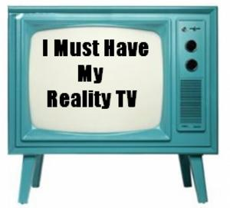
Reality TV
Make a list of 3 arguments against reality
TV programmes.

Slide 6
Reality TV
Reality TV
Big Brother
http://www.youtube.com/watch?v=v0G6OX
din0 (up to 2.48)
I’m a celebrity
http://www.youtube.com/watch?v=gJpJEc
RY4
If you’ve read the book/seen the film
Write down any similarities you notice between these programmes and the dystopia created in the novel.
If you know nothing about the book
Write down all the elements of reality TV that you notice that you think could be elements of the dystopia Suzanne Collins has created.

Slide 7
Work with your partner and jot down in your book:
Why is ‘The Hunger Games’ a dystopian novel?

